Slide 1
Software Quality Management
Lecturer: Ngo Huy Bien
Software Engineering Department
Faculty of Information Technology
VNUHCM - University of Science
Ho Chi Minh City, Vietnam
nhbien@fit.hcmus.edu.vn

Slide 2

Objectives
To meet business, user and technical requirements
To measure quality characteristics of a product, a project, a process and a person
To present what is quality, how to perform quality management and why quality management is important
To create a quality management plan
To present key concepts of ISO 9001

Slide 3

Contents
Quality characteristics
Quality metrics
Quality measurement
Quality standards
Quality management

Slide 4

References
J.A. McCall et al. (1977). Factors in Software Quality.
Robert T. Futrell et al. (2002). Quality Software Project Management.
Shari Lawrence Pfleeger et al. (1997). Status Report on Software Measurement.
Stephen H. Kan. (2002). Metrics and Models in Software Quality Engineering.
G. Canfora et al. (2005). A Family of Experiments to Validate Metrics for Software Process Models.
Paul Pocatilu (2007). IT Project Management Metrics.
ISO (2008). Guidance on the Documentation Requirements of ISO 9001.
Aston. 14 Steps to Implementing ISO 9001 Quality Management System.

Slide 5

Why Do Projects Fail?
Product delivered → Client/Sponsor/Users → Not Accepted.
Product → Low Quality → No Usage → Failure.
Highest Quality → Not Necessary (High Cost).
Goal: Acceptable Quality and Cost.

Slide 6

How to Meet Business Requirements
Budget and revenue
Baselines and standards:
Similar systems (to be compared with)

Slide 7

How to Meet User Requirements
Problems solved? Objectives achieved?
Baselines/standards:
Examples (to be compared with)
Real world manual business processes (no software): Yes/No
Prototype (workflow/story map) → Exploratory tests (workflow/story map + BAD/MALICIUOS inputs/Hacking)
Test cases?
Use cases?
Quality of test cases!!!

Slide 8

Example: Performance Requirements
Response: Standard 3s
CPU usage: Standard 25%
RAM usage: Standard 600Mb

Slide 9

How to Meet Technical Requirements
Definition of done?
Coding standards, coding conventions?
Unit tests?
Examples?
Experts?
Quality of unit tests!!!

Slide 10

Example: Security Requirements
Server
? (OS)
Code
? (Penetration Testing, Components)
Protocols:
? (TLS 1.2)

Slide 11
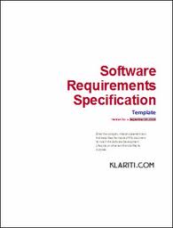
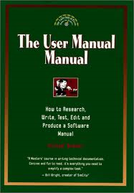
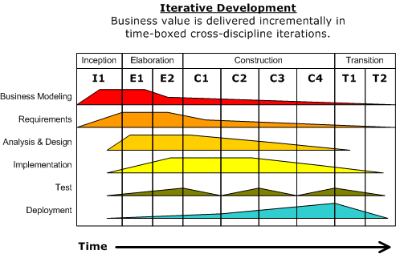

How to Meet Document and Process Quality Requirements?
What is mechanism for specifying the quality of documents or process.

Slide 12


Products, Process, Project and Environment Quality
Program & Source Code
Software Requirements Specification
Software Design Specification
Software Testing Specification
Software Development Process
Software Project Plan
Software Risk Management Plan
Software Quality Assurance Plan
Software Team
Environment

Slide 13


Slide 14

1. Select a Product
In fact, select any artifact.

Slide 15

What is Quality?
Quality is the degree to which a set of inherent characteristics fulfills requirements (need or expectation).

Slide 16

External Quality Characteristics [1]
Characteristic – A condition which actively contributes to the quality of the software.
CORRECTNESS. Extent to which a program satisfies its specifications and fulfills the user's mission objectives.
RELIABILITY Extent to which a program can be expected to perform its intended function with required precision.
EFFICIENCY The mount of computing resources and code required by a program to perform a function.
INTERITY Extent to which access to software or data by unauthorized persons can be controlled.
USABILITY Effort required to learn, operate, prepare input, and interpret output of a program.
MAINTAINAILITY Effort required to locate and fix an error in an operational program.
TESTABILTY Effort required to test a program to insure it performs its intended function.
FLEXIBILITY Effort required to modify an operational program.
PORTABILITY Effort required to transfer a program from one hardware configuration and/or software system environment to another.
REUSABILITY Extent to which a program can be used in other applications - related to the packaging and scope of the functions that programs perform.
INTEROPEABILITY Effort required to couple one system with another.

Slide 17
ISO 9126 Quality Characteristics [2]
Quality Characteristic | Subcharacteristic
Functionality (Are the required functions available in the software?) Functionality is the set of attributes that bear on the existence of a set of functions and their specified properties. | Suitability
 | Accuracy
 | Interoperability
 | Security
Reliability (How reliable is the software?) Reliability is the set of attributes that bear on the capability of software to maintain its level of performance under stated conditions for a stated period of time. | Maturity
 | Fault tolerance
 | Recoverability
Usability (Is the software easy to use?) Usability is the set of attributes that bear on the effort needed for use, and on the individual assessment of such use, by a stated or implied set of users. | Understandability
 | Learnability
 | Operability
 | Attractiveness
Efficiency (How efficient is the software?) | Time behavior
 | Resource behavior
Maintainability (How easy is it to modify the software?) | Analyzability
 | Changeability
 | Stability
 | Testability
Portability (How easy is it to transfer the software to another operating environment?) | Adaptability
 | Installability
 | Coexistence
 | Replace-ability

Slide 18

2. Select Quality Characteristics
How many characteristics?

Slide 19

3. Define Metrics
Software measurement gathers information about the software product, process, project and environment.
We have to turn our vague ideas about quality into something measurable.
Example: Software quality characteristics
Correctness (vague idea)
Test cases (measurable quantities)
Number of passed test cases (counts, metrics)
Usability (vague idea)
Time taken to learn how to use system (measurable quantities)
Average learning time of 100 users (counts, metrics)

Slide 20

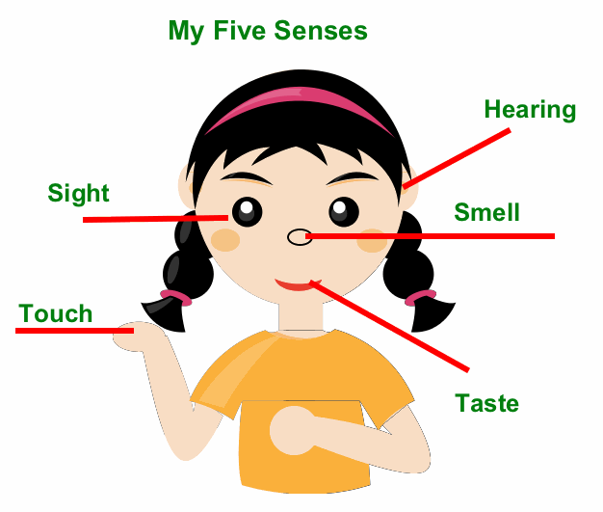

Data
Qualitative Data | Quantitative Data
robust aroma frothy appearance strong taste | 12 ounces of latte serving temperature 150º F. serving cup 7 inches in height cost $4.95

Slide 21
A Test
The age of your car.
The number of hairs on your knuckle.
The softness of a cat.
The color of the sky (expressed as blue, hazel, brown, etc.).
The number of pennies in your pocket.

Slide 22
Answers
The age of your car.
Quantitative.
The number of hairs on your knuckle.
Quantitative.
The softness of a cat.
Qualitative.
The color of the sky (expressed as blue, hazel, brown, etc.).
Qualitative.
The number of pennies in your pocket.
Quantitative.

Slide 23

5. Select Evaluation Method
Qualitative Measurement | Quantitative Measurement
Deals with descriptions (words, categories). Data can be observed but not measured. Colors, textures, smells, tastes, appearance, beauty, etc. 'Good job!' or 'He wasn't very nice.' Qualitative → Quality Qualitative measurement collects information that is not numerical. | Deals with numbers. Data which can be measured. Length, height, area, volume, weight, speed, time, temperature, humidity, sound levels, cost, members, ages, etc. Quantitative → Quantity Quantitative measurement is measurement of data that can be put into numbers.

Slide 24

6. Define Quality Requirements
Quality is the degree to which a set of inherent characteristics fulfills requirements (need or expectation).
No requirements (no baselines, no standards) → No quality.
Meets
Quality characteristics
Quality requirements
Quality requirements should be included in a specification.

Slide 25
Example Quality Requirements
Quality is the degree to which a set of inherent characteristics fulfills requirements (need or expectation).
Number of passed test cases: 100%
Average learning time of 100 users: 10 minutes
Unit tests coverage: ?
UIs: ?
Business processes: ?

Slide 26
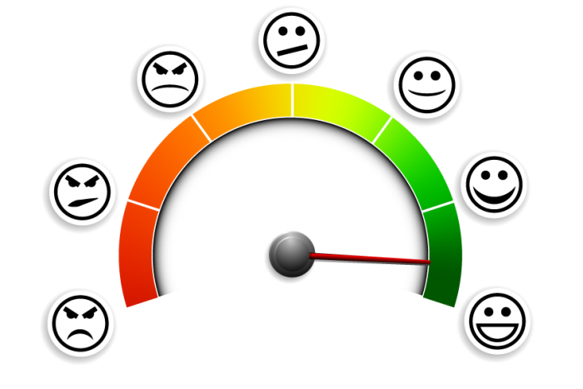

Software Quality Standards
Software quality management is concerned with ensuring that software meets its required standards.
Software standards are an encapsulation of best practice.
There are no standardized and universally applicable software metrics.
Quantification (metrics)?

Slide 27

Summary: How to Manage Quality of Something? [3]
Describe the entity being measured (product).
Describe what you want to find out (characteristics).
Describe the attributes you will measure and the set of possible resulting measures (metrics).
Describe how to approach measuring the attributes (evaluation method).
Have standards to compare against (requirements).
Example:
1. Software application
2. Performance > Resource utilization
3. CPU utilization, memory utilization
4. Run the application, start Task Manager, locate values
5. Max CPU utilization: 10%, max memory utilization: 200Mb

Slide 29
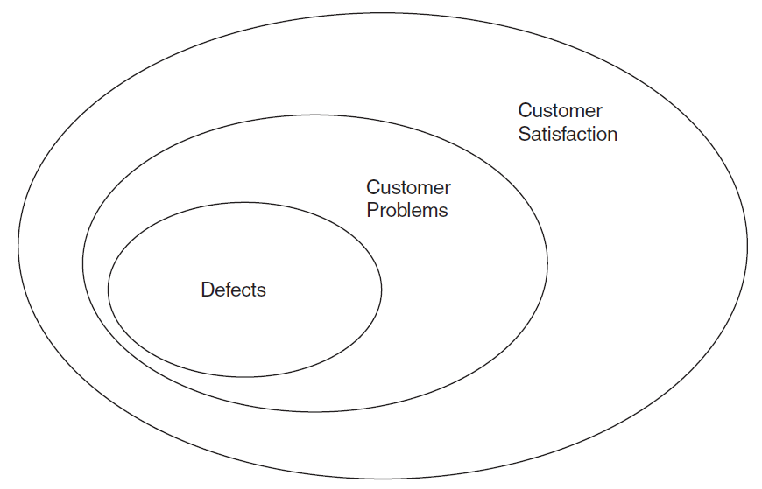

Software Quality Metrics (Customer’s View) [4]
Mean time to failure
The time between failures
Defect density (rate)
The defects relative to the
software size (lines of code, function points, etc.)
Customer problems
Total problems that customers reported (true defects and non-defect-oriented problems) for a time period
Customer satisfaction
Customer survey (Satisfied, Neutral, Dissatisfied)

Slide 30
Process Quality Characteristics [5]
Maintainability Sub-characteristic | Definition
Analyzability | Easiness shown by the model in discovering errors or deficiencies and in guessing the parts that should be modified.
Understandability | Easiness with which the model can be understood.
Modifiability | Easiness with which the model can be modified, for possible errors, a specific modification request or new requirements.

Slide 31
Process Quality Metrics
Metric | Definition
NA | Number of activities of the software process model
NWP | Number of work products of the software process model
NPR | Number of roles which participate in the process
NDWPIn | Number of input dependences of the work products with the activities in the process
NDWPOut | Number of output dependences of the work products with the activities in the process
NDWP | Number of dependences between work products and activities NDWP(PM) = NDWPIn(MP) + NDWPOut(MP)
NDA | Number of precedence dependences between activities
… | …

Slide 32
Project Quality Metrics [6]
Category | Metrics
Productivity | The number of lines of code/modules/classes/deliverables etc. developed on time unit or per resource
Quality | Project complexity Portfolio complexity The degree of client or executive management satisfaction by completing the project objectives
Deliverables | The ratio between the achieved deliverables and the planned deliverables The number of reworks because of no concordances between the specifications and the results
Costs | Statistics regarding different costs categories Project portfolio value
Resources | Statistics regarding resources usage Statistics regarding resources costs Statistics regarding resources loading and distribution

Slide 33
Person Quality Metrics
Metric | Subjective evaluation
Social abilities | Use well known models
Personnel experience | The years of experience in the project’s specific field.
Degree of satisfaction | Sum of the degree of satisfaction for each requirement / total number of requirements

Slide 35

7. Create Quality Management Plan
The products, project, process, and environment selection
The entity attributes selection
The quality requirements
The methods to evaluate the selected entities
Qualitative (CATEGORIES): subjective
Quantitative (HOW MANY): objective

Slide 36


Software Quality Assurance Plan
Purpose
Reference documents
Management
Documentation
Standards, practices, conventions, and metrics
Software reviews
Test
Problem reporting and corrective action
Tools, techniques, and methodologies
Media control
Supplier control
Records collection, maintenance, and retention
Training
Risk management
Glossary
SQAP change procedure and history
The IEEE 730-2002

Slide 37

8. Perform Quality Assurance
Quality assurance is the part of quality management focused on providing confidence that quality requirements will be fulfilled.
QA
Process (PQA)
Products (SQA)
People
Services
The purpose of quality assurance is to prevent defects.
Process definition
Training
…
Tools selection

Slide 38

9. Perform Quality Control
Quality control is the part of quality management focused on fulfilling quality requirements.
QC
Process
Products
People
Services
The purpose of quality control is to detect defects.
Lowest number of errors.
Desk-checks
Walkthrough
Testing
Inspection
…

Slide 39

Test Management Tools
https://app.qase.io/signup
https://ontestpad.com/signup
https://trello.com/signup

Slide 40

Who is Responsible for Quality?

Slide 41

When to Manage Quality?
Statement of work.
Project charter.
Project vision and scope.

Slide 42

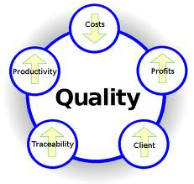
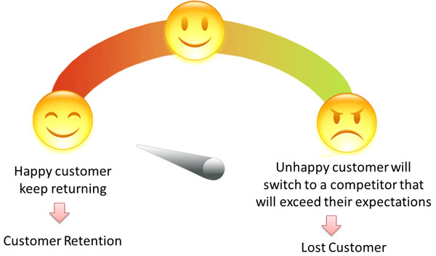
Why Quality Management?
Improving customer’s satisfaction
Reducing development cost
Reducing maintenance cost
Required by some standards (ISO, CMMI)

Slide 43

QA/QC Hire (HP)
Bachelor’s Degree in Computer Science/Software Engineering or comparable.
Solid understanding of, and practical experience with software quality tools and processes (e.g. test planning, progress tracking, defect tracking, black box/white box testing, code coverage measurement, code complexity measurement, code analyzers, test automation, etc.).
Knowledge of SW Engineering tools (e.g. source code revision control systems, build process, etc.).
Thorough understanding of the entire Software Development process (using traditional waterfall-like development and/or agile/iterative development) in order to establish quality metrics and practices along the development cycle and not only in final product testing.
Experience working with customers (understanding customer needs/expectations).
Define and measure product quality.
Define and establish appropriate quality management processes and tools across the R&D organization.
Work closely with the Development and QA teams to establish and execute appropriate practices to actually meet the defined quality goals.
Work closely with the Management team to report on relevant quality metrics, and make recommendations as to whether a product is ready to be released to customers.
Look for opportunities to increase product quality and team efficiency, and drive improvement programs across the entire development project.

Slide 44
Test vs. Evaluation vs. Assessment
Test is the process of measuring a quality attribute quantitatively or qualitatively.
Input → Test → Output vs. Expected Output.
Product A passes performance test.
Evaluation is the process of making judgments based on criteria and evidence. An evidence can be a test.
Evidence → Criteria → Score → Judgement.
Product A is better product B.
Assessment is the process of collecting information, performing tests, making evaluation and providing conclusion.
We should use product A for our project.
Product A meets our requirements.

Slide 46
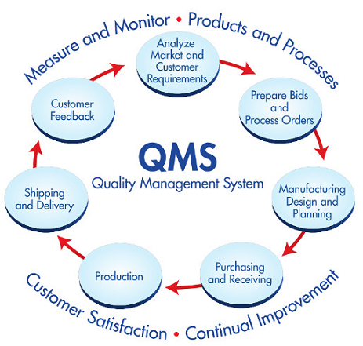
What is a Quality Management System? [7]
A quality management system is a way of defining how an organization can meet the requirements of its customers and other stakeholders affected by its work.

Slide 47

International Standards Organization
ISO (the International Organization for Standardization) is a worldwide federation of national standards bodies (ISO member bodies).
The work of preparing International Standards is normally carried out through ISO technical committees.
Each member body interested in a subject for which a technical committee has been established has the right to be represented on that committee.
International organizations, governmental and non-governmental, in liaison with ISO, also take part in the work.

Slide 48

ISO 9000
ISO 9000:2008 specifies the terms and definitions that apply to all quality management and quality management system standards developed by ISO/TC 176.

Slide 49

ISO 9001
ISO 9001 is a standard that sets out the requirements for a quality management system.
It helps businesses and organizations to be more efficient and improve customer satisfaction.
ISO 9001 is based on the idea of continual improvement.
It doesn’t specify what the objectives relating to “quality” or “meeting customer needs” should be, but requires organizations to define these objectives themselves and continually improve their processes in order to reach them.

Slide 50
ISO 19011 and ISO 9004
ISO 19011 gives guidance for performing both internal and external audits to ISO 9001.
This will help ensure your quality management system delivers on promise and will prepare you for an external audit, should you decide to seek third-party certification.
ISO 9004 provides guidance on how to achieve sustained success with your quality management system.

Slide 51

Why ISO 9001?
Management problems happened
Quality control approach showed failure
Certificate is required

Slide 52
ISO 9001:2008 Terms and Definitions
Document – information and its supporting medium
Procedure – specified way to carry out an activity or a process (Note: Procedures can be documented or not)
Quality Manual – document specifying the quality management system of an organization
Quality Plan – document specifying which procedures and associated resources shall be applied by whom and when to a specific project, product, process or contract
Record – document stating results achieved or providing evidence of activities performed
Specification – document stating requirements

Slide 53
Records Required by ISO 9001:2008
Management reviews
Education, training, skills and experience
Evidence that the realization processes and resulting product fulfill requirements
Design and development inputs relating to product requirements
Results of design and development reviews and any necessary actions
Results of design and development validation and any necessary actions
Results of the review of design and development changes and any necessary actions
…

Slide 54
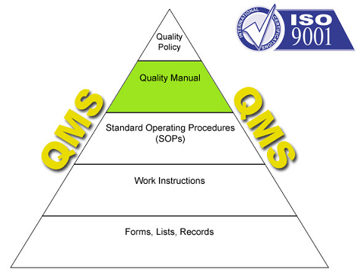
What Should We Do?
Quality assurance procedures should be documented in an organizational quality manual.

Slide 55

Implement ISO 9001 Quality Management System (I) [8]
Top management commitment
Establish implementation team
Start ISO 9000 awareness programs
Provide Training
Conduct initial status survey

Slide 56
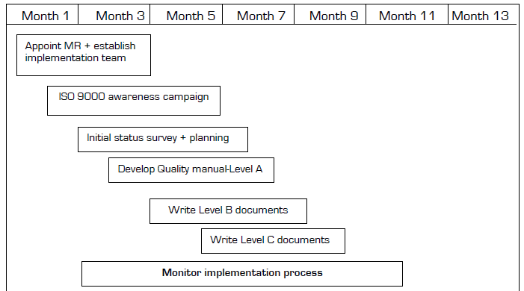
Implement ISO 9001 Quality Management System (II)
Create a documented implementation plan

Slide 57
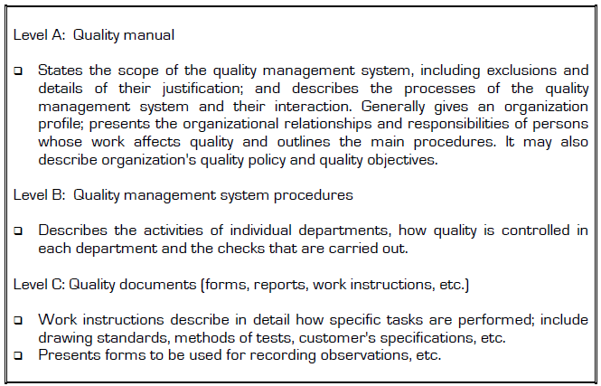
Implement ISO 9001 Quality Management System (III)
Develop quality management system documentation (Use ISO 10013:1995 for guidance in quality documentation.)

Slide 58
Implement ISO 9001 Quality Management System (IV)
Document control (Control is simply a means of managing the creation, approval, distribution, revision, storage, and disposal of the various types of documentation.)
Implementation
Internal quality audit (Use ISO 19011 for guidance in auditing, auditor qualification and programmes.)
Management review
Pre-assessment audit
Certification and registration
Continual Improvement (ISO 9004:2008 provides a methodology for continual improvement).

Slide 59

Thank You & See You Again

